Slide 1
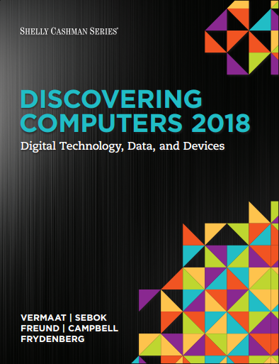

DISCOVERING COMPUTERS 2018 Digital Technology, Data, and Devices
Module 6
Computing Components: Processors, Memory, the Cloud, and More
Copyright © 2018 Cengage Learning®. May not be scanned, copied or duplicated, or posted to a publicly accessible website, in whole or in part.

Slide 2
Objectives Overview (1 of 2)
Describe the various computer and mobile device cases and the contents they protect
Describe multi-core processors, the components of a processor, and the four steps in a machine cycle
Identify characteristics of various personal computer processors on the market today, and describe the ways processors are cooled
Describe what is meant by the Internet of Things
Explain the advantages and services of cloud computing

Slide 3
Objectives Overview (2 of 2)
Define a bit, and describe how a series of bits represents data
Explain how program and application instructions transfer in and out of memory
Differentiate among the various types of memory
Describe the purpose of adapter cards and USB adapters
Explain the function of a bus
Explain the purpose of a power supply and batteries
Describe how to care for computers and mobile devices

Slide 4
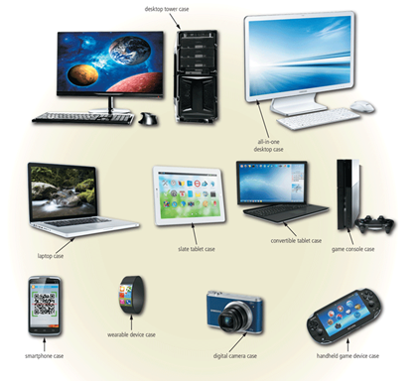
Inside the Case (1 of 3)
The case contains and protects the electronics of the computer or mobile device from damage
Figure 6-1 Cases for computers and mobile devices are available in a variety of shapes and sizes

Slide 5
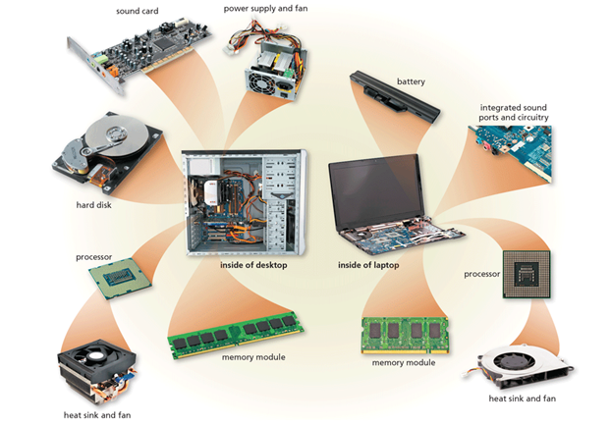
Inside the Case (2 of 3)
Figure 6-2 This figure shows typical components in a higher-end desktop and laptop. Many basic desktops have integrated video and sound capability, similar to the laptop image shown here.

Slide 6
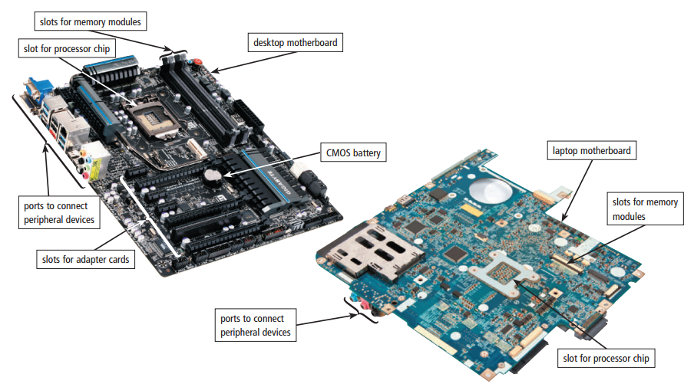
Inside the Case (3 of 3)
The motherboard is the main circuit board of the computer
A computer chip is a small piece of semiconducting material, usually silicon, on which integrated circuits are etched
Figure 6-3 A desktop motherboard and a laptop motherboard.

Slide 7
Processors (1 of 9)
The processor, also called the central processing unit (CPU), interprets and carries out the basic instructions that operate a computer
A multi-core processor is a single chip with two or more separate processor cores
Processors contain a control unit and an arithmetic logic unit (ALU)

Slide 8
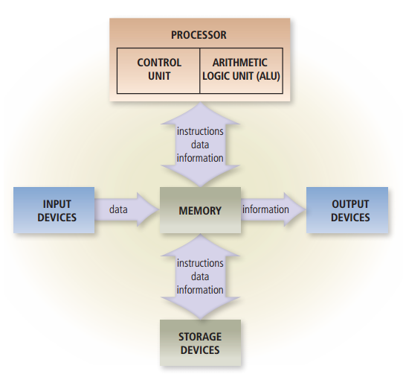
Processors (2 of 9)
Figure 6-4 Most devices connected to the computer communicate with the processor to carry out a task.

Slide 9
Processors (3 of 9)
The control unit is the component of the processor that directs and coordinates most of the operations in the computer
The arithmetic logic unit (ALU), another component of the processor, performs arithmetic, comparison, and other operations

Slide 10
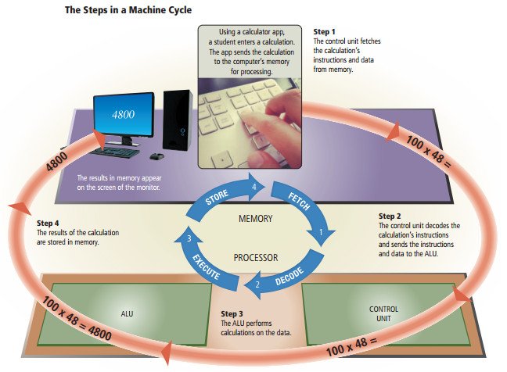
Processors (4 of 9)
For every instruction, a processor repeats a set of four basic operations, which comprise a machine cycle
Figure 6-5 This figure shows the steps in a machine cycle.

Slide 11
Processors (5 of 9)
The processor contains registers, that temporarily hold data and instructions
The system clock controls the timing of all computer operations
The pace of the system clock is called the clock speed, and is usually measured in gigahertz (GHz)

Slide 12
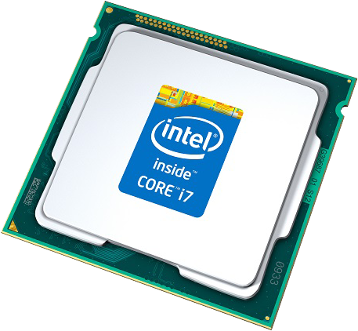
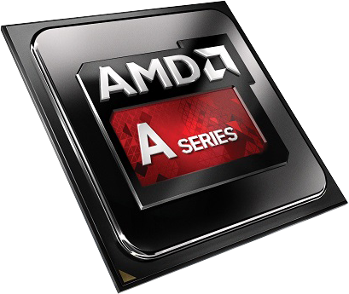
Processors (6 of 9)
The leading manufacturers of personal computer processor chips are Intel and AMD

Slide 13
Processors (7 of 9)
A processor chip generates heat that could cause the chip to malfunction or fail
Require additional cooling
Heat sinks
Liquid cooling technology
Cooling pads

Slide 14
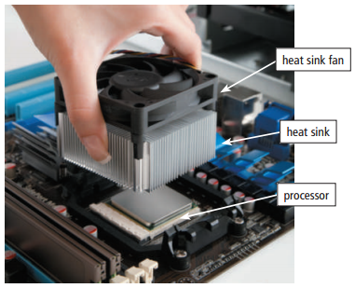
Processors (8 of 9)
Figure 6-6 This photo shows a heat sink being attached to the top of a processor to prevent the chip from overheating.

Slide 15
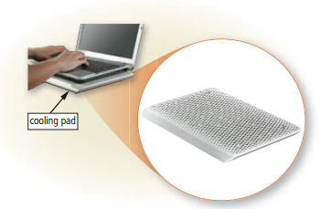
Processors (9 of 9)
Figure 6-7 A laptop cooling pad helps reduce heat generated by a laptop.

Slide 16
Cloud Computing
Home and business users choose cloud computing for a variety of reasons
Accessibility
Cost savings
Space savings
Scalability

Slide 17
Internet of Things (IoT)
Computers and mobile devices are not the only things that connect to the Internet
A thermostat contains a temperature sensor that can send and receive data
A wireless chip attached to a medicine bottle can send text messages to remind a person to take medication
Smart trash cans in public places have sensors that monitor the amount of trash deposited
A smart city uses the loT, as well as advanced communications technologies, to help manage the city

Slide 18
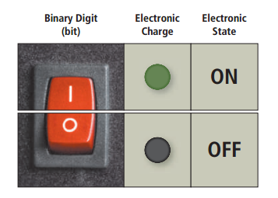
Data Representation (1 of 3)
Analog signals are continuous and vary in strength and quality
Digital signals are in one of two states: on or off
Most computers are digital
The binary system uses two unique digits (0 and 1)
Bits and bytes
Figure 6-8 The circuitry in a computer or mobile device represents the on or the off states electronically by the presence or absence of an electronic charge.

Slide 19
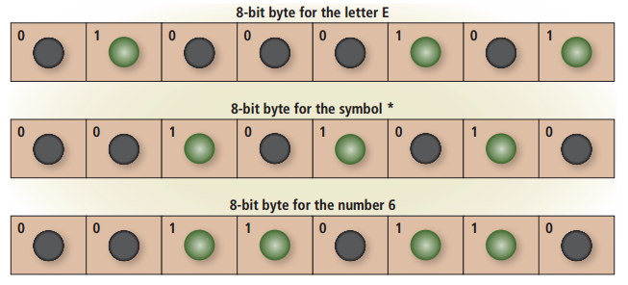
Data Representation (2 of 3)
Figure 6-9 Eight bits grouped together as a unit are called a byte. A byte represents a single character in the computer or mobile device.

Slide 20
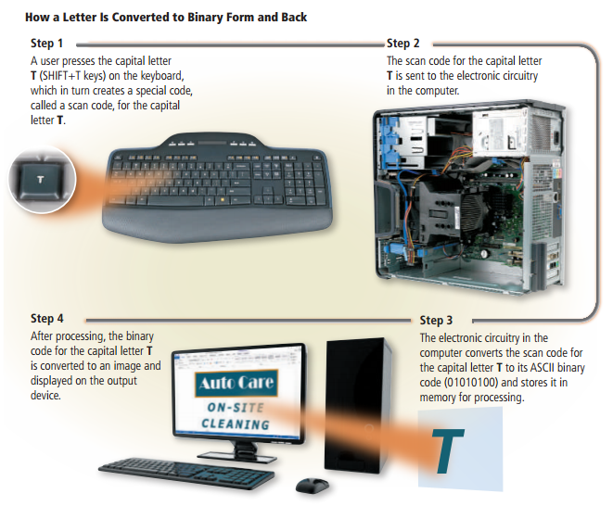
Data Representation (3 of 3)
Figure 6-10 This figure shows how a letter is converted to binary form and back.

Slide 21
Memory (1 of 10)
Memory consists of electronic components that store instructions waiting to be executed by the processor, data needed by those instructions, and the results of processing the data
Stores three basic categories of items:
The operating system and other programs
Applications
Data being processed and the resulting information

Slide 22
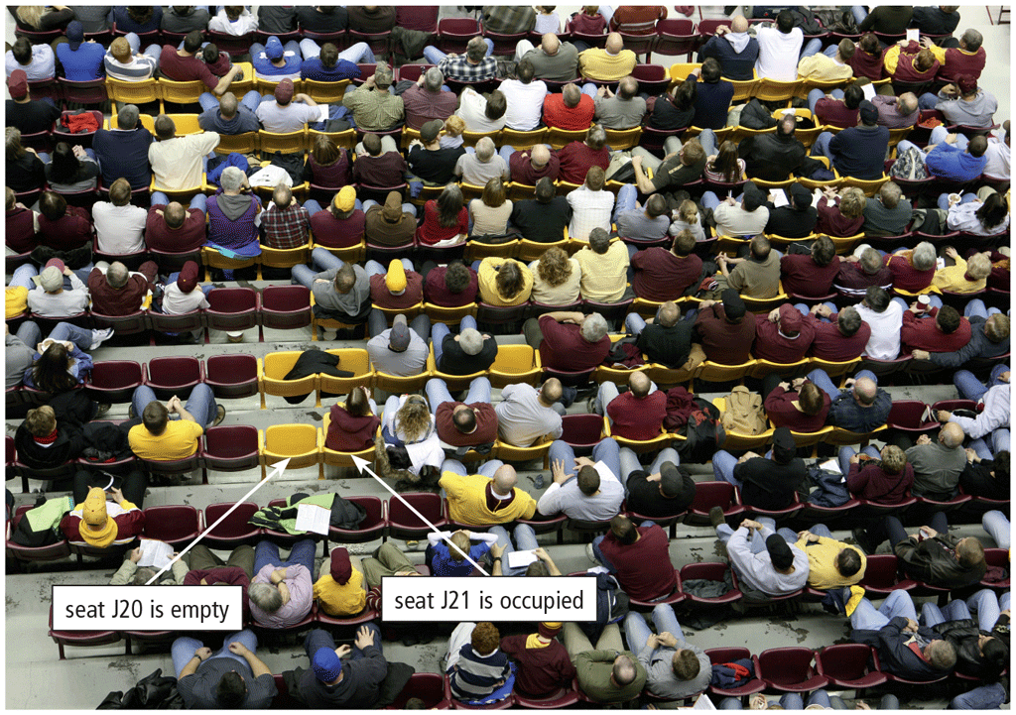
Memory (2 of 10)
Each byte resides temporarily in a location in memory that has an address
Memory size commonly is measured in gigabytes (GB)

Slide 23
Memory (3 of 10)
Computers and mobile devices contain two types of memory:
Volatile memory
Loses its contents when power is turned off
Example includes RAM
Nonvolatile memory
Does not lose contents when power is removed
Examples include ROM, flash memory, and CMOS

Slide 24
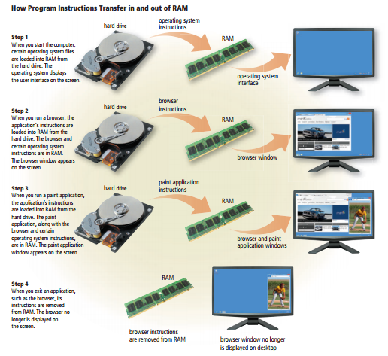
Memory (4 of 10)
Figure 6-12 This figure shows how program and application instructions transfer in and out of RAM.

Slide 25
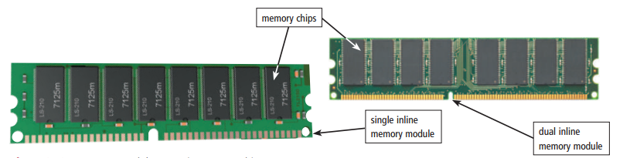
Memory (5 of 10)
Two common types of RAM exist:
Dynamic RAM (DRAM)
Static RAM (SRAM)
RAM chips usually reside on a memory module and are inserted into memory slots
Figure 6-13 Memory modules contain memory chips.

Slide 26
Memory (6 of 10)
Table 6-1 Common DRAM Variations
Name | Comments
SDRAM (Synchronous DRAM) | Synchronized to the system clock Much faster than DRAM
DDR SDRAM (Double Data Rate SDRAM) | Transfers data twice, instead of once, for each clock cycle Faster than SDRAM
DDR2 | Second generation of DDR Faster than DDR
DDR3 | Third generation of DDR Designed for computers with multi-core processors Faster than DDR2
DDR4 | Fourth generation of DDR Faster than DDR3
RDRAM (Rambus DRAM) | Much faster than SDRAM

Slide 27
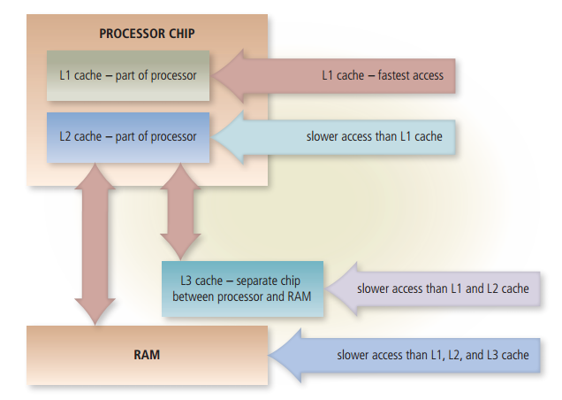
Memory (7 of 10)
Memory cache speeds the processes of the computer because it stores frequently used instructions and data
Figure 6-14 Memory cache helps speed processing times when the processor requests data, instructions, or information.

Slide 28
Memory (8 of 10)
Read-only memory (ROM) refers to memory chips storing permanent data and instructions
Firmware
Flash memory can be erased electronically and rewritten
CMOS technology uses battery power to retain information when the power to the computer is off

Slide 29
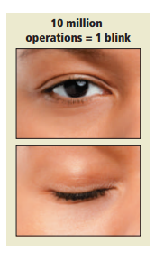
Memory (9 of 10)
Access time is the amount of time it takes the processor to read from memory
Measured in nanoseconds
Figure 6-15 It takes about one-tenth of a second to blink your eye, in which time a computer can perform some operations 10 million times.

Slide 30
Memory (10 of 10)
Table 6-2 access Time Terminology
Term | Abbreviation | Speed
Millisecond | ms | One-thousandth of a second
Microsecond | µs | One-millionth of a second
Nanosecond | ns | One-billionth of a second
Picosecond | ps | One-trillionth of a second

Slide 31
Adapters (1 of 4)
An adapter card enhances functions of a component of a desktop or server system unit and/or provides connections to peripheral devices
Sound card and video card
An expansion slot is a socket on a desktop or server motherboard that can hold an adapter card

Slide 32
Adapters (2 of 4)
Table 6-3 adapter cards
Type | Purpose
Bluetooth | Enables Bluetooth connectivity
MIDI | Connects to musical instruments
Modem | Connects to transmission media, such as cable television lines or phone lines
Network | Provides network connections, such as to an Ethernet port
Sound | Connects to speakers or a microphone
TV tuner | Allows viewing of digital television broadcasts on a monitor
USB | Connects to high-speed USB ports
Video | Provides enhanced graphics capabilities, such as accelerated processing or the ability to connect a second monitor
Video capture | Connects to a digital video camera

Slide 33
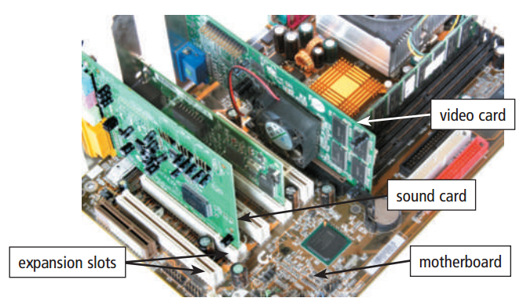
Adapters (3 of 4)
With Plug and Play technology, the computer automatically can recognize peripheral devices as you install them
Figure 6-16 Cards inserted in expansion slots on a desktop motherboard.

Slide 34
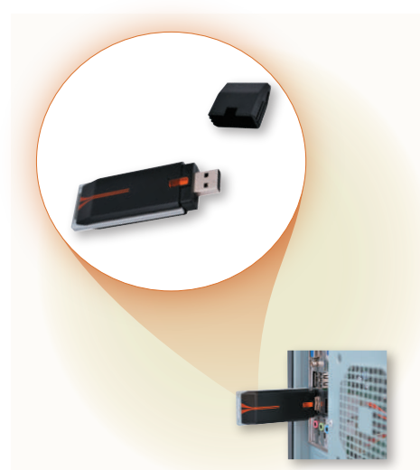
Adapters (4 of 4)
A USB adapter enhances functions of a mobile computer and/or provides connections to peripheral devices
Figure 6-17 A USB adapter inserts into a USB port on a computer or mobile device.

Slide 35
Buses (1 of 3)
A bus allows the various devices both inside and attached to the system unit to communicate with one another
Data bus
Address bus
Word size is the number of bits the processor can interpret and execute at a given time

Slide 36
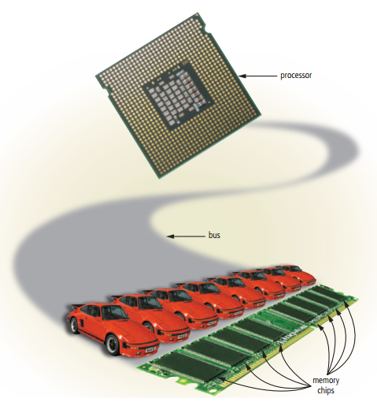
Buses (2 of 3)
Figure 6-18 Just as vehicles travel on a highway, bits travel on a bus. Buses are used to transfer bits from input devices to memory, from memory to the processor, from the processor to memory, and from memory to output or storage devices.

Slide 37
Buses (3 of 3)
A computer might have these three types of buses:
System bus
Backside bus
Expansion bus

Slide 38
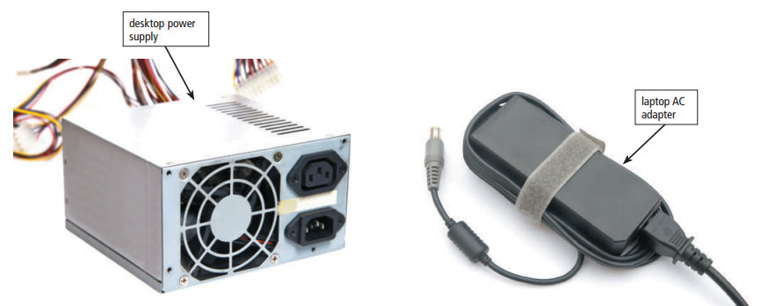
Power Supply and Batteries (1 of 2)
The power supply or laptop AC adapter converts the wall outlet AC power into DC power
Figure 6-19 Examples of desktop power supply and laptop AC adapter.

Slide 39
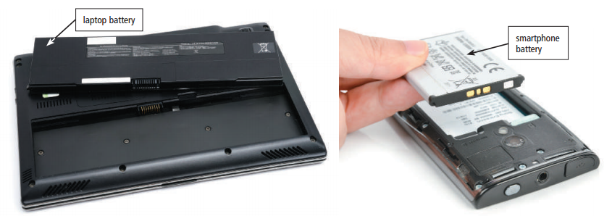
Power Supply and Batteries (2 of 2)
Mobile computers and devices can run using either a power supply or batteries
Batteries typically are rechargeable lithium-ion batteries
Figure 6-20 Rechargeable batteries for mobile computers and devices.

Slide 40
Summary
Various components inside computers and mobile devices
Types of processors, steps in a machine cycle, and processor cooling methods
Advantages and services of cloud computing
How memory stores data and various types of memory
Adapters, buses, power supplies and batteries
Ways to care for computers and mobile devices

